Slide 1

Elevator Management System
Group No 10:
Akshita Barot - 002704943
Aniruddha Tambe - 002101113
Forum Bhatt - 002985519
Kinjal Thakkar - 001568960
Siddhant Kohli - 002108396

Slide 2

Main Contents
Introduction
Entity Relationship Diagram
Database Implementation
Reports and Visualization
Conclusion

Slide 3

Database Purpose
To design & implement a database that maintains consistent records of client data
Introduce sales pipeline tracking & accurate business KPIs computation
Introduce call-backs, sales & maintenance jobs for tracking business entities

Slide 4
Business Problems Addressed
Allow elevator team to generate descriptive reports
Implement callback (complaints) registering
Implement maintenance job pipeline
Implement YTD revenue pipeline
Generate business insights
Inventory & merchandise management

Slide 5

Entity relationship diagram

Slide 6
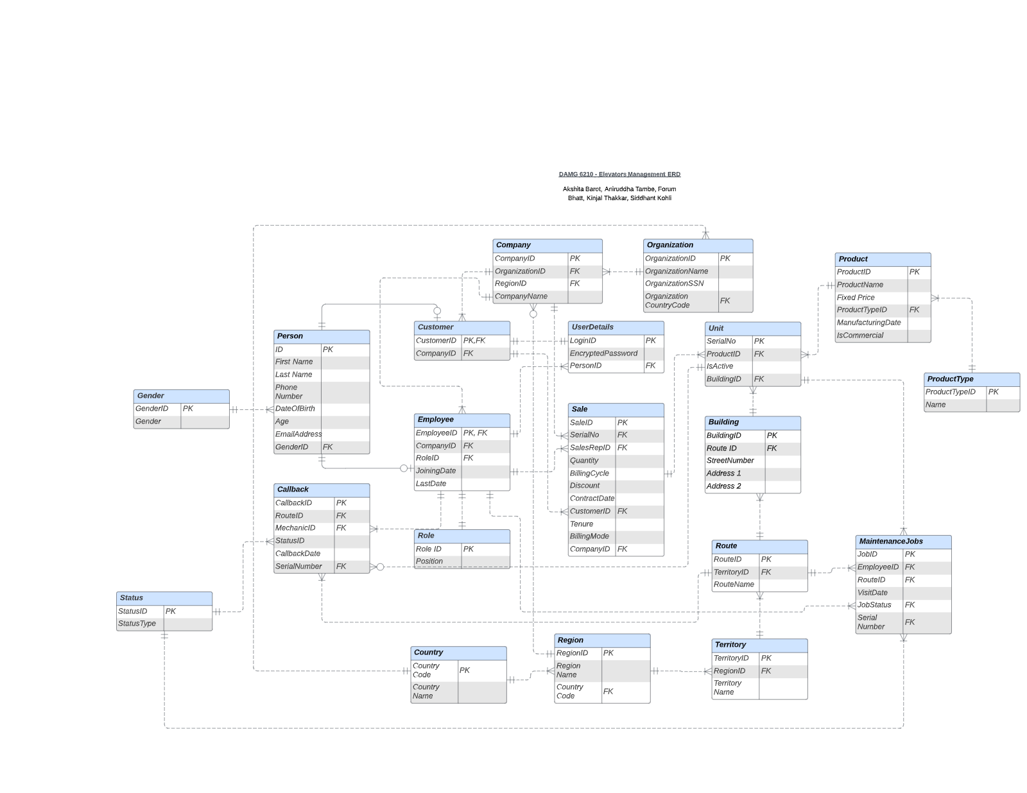

Slide 7
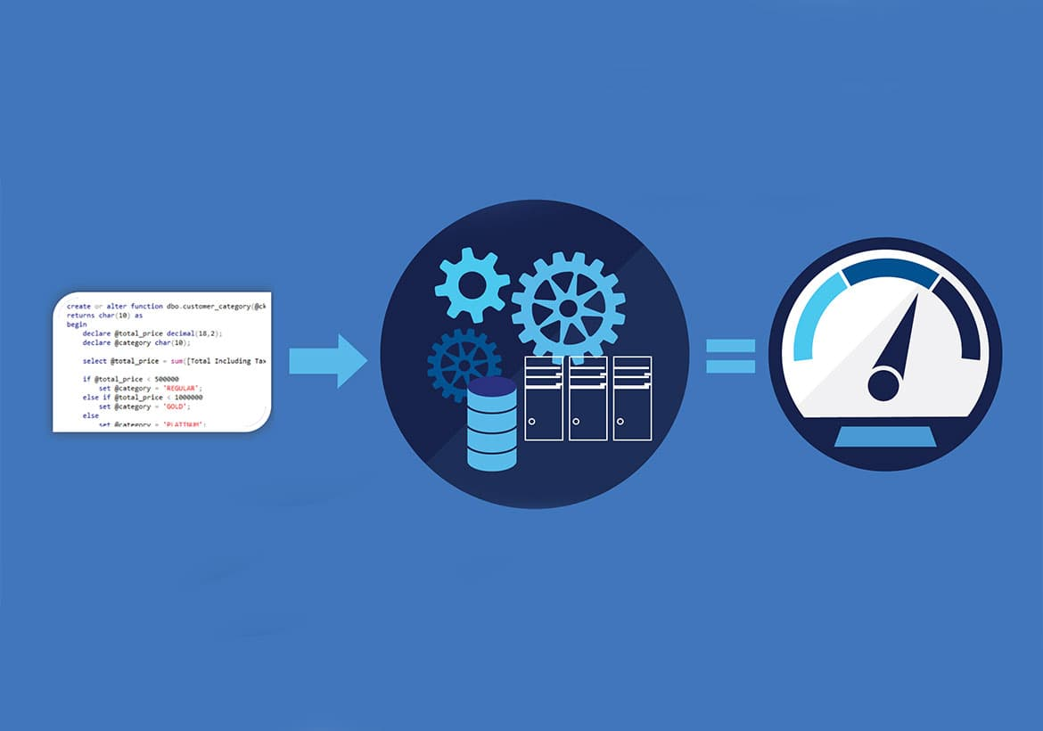
Database Implementations

Slide 8
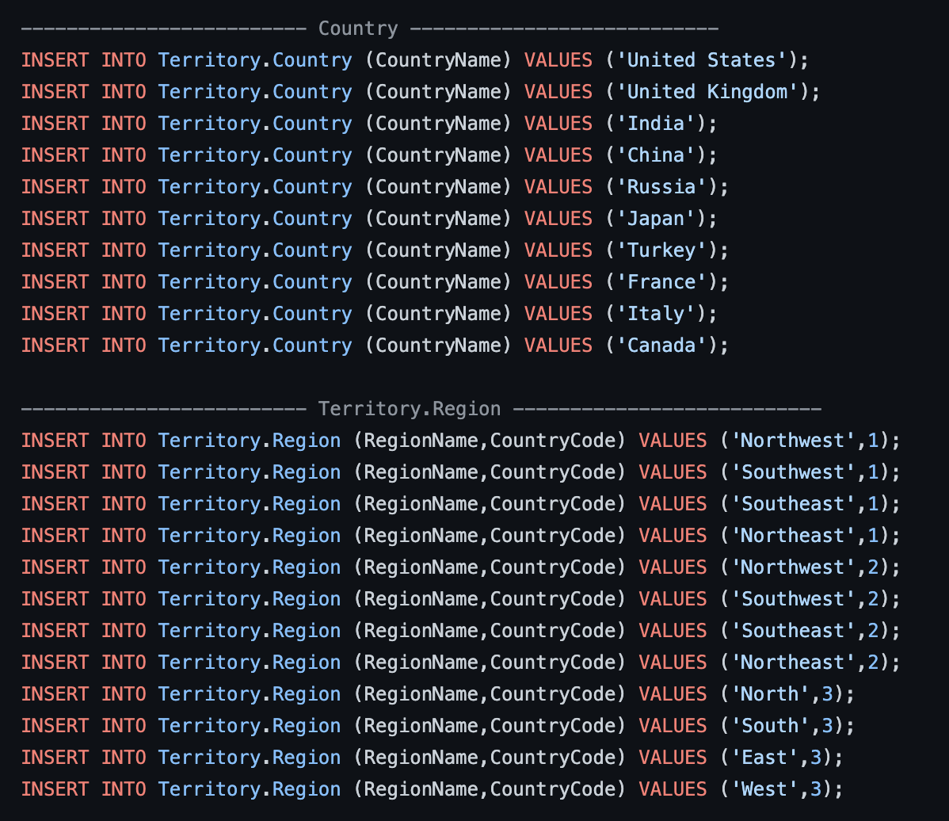
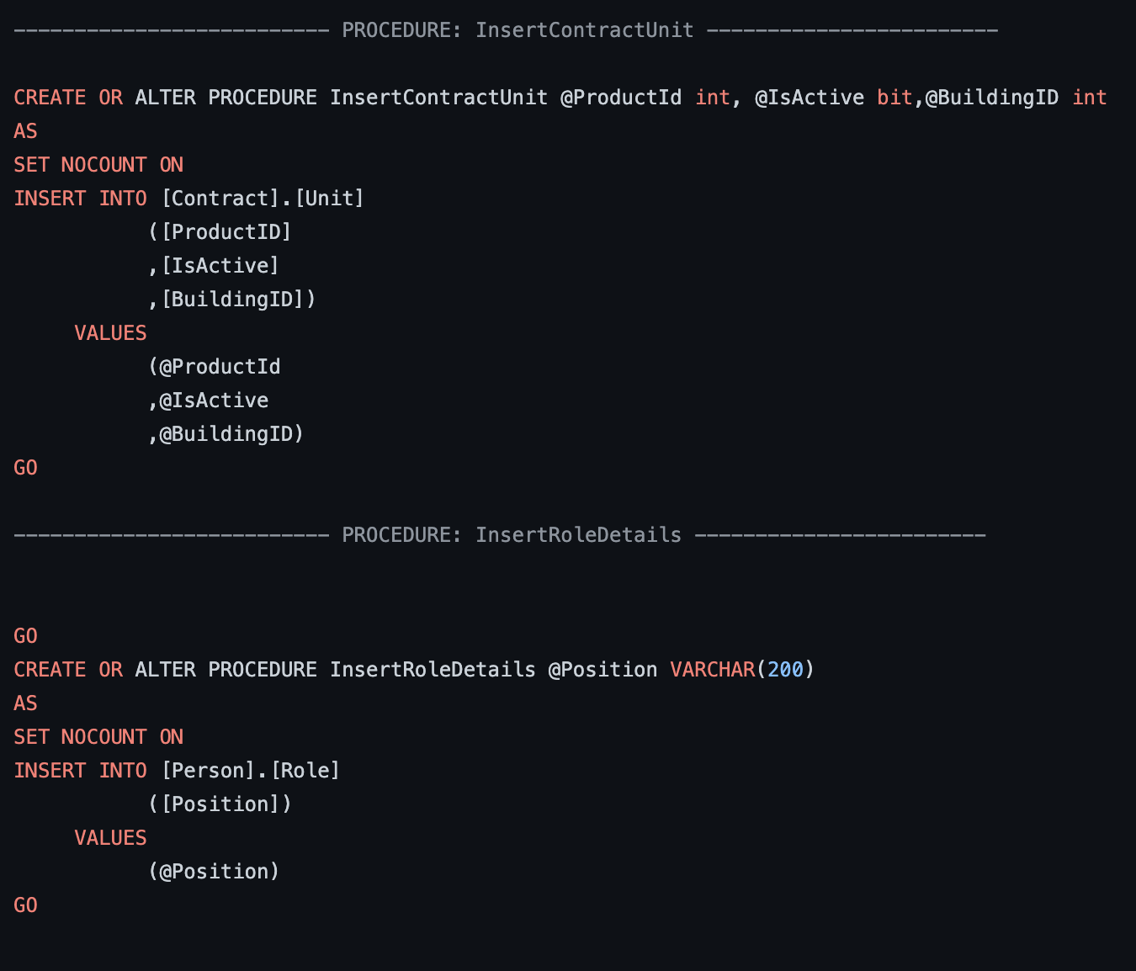
Create Database Framework
Insert Queries
Insert Queries by Procedures

Slide 9
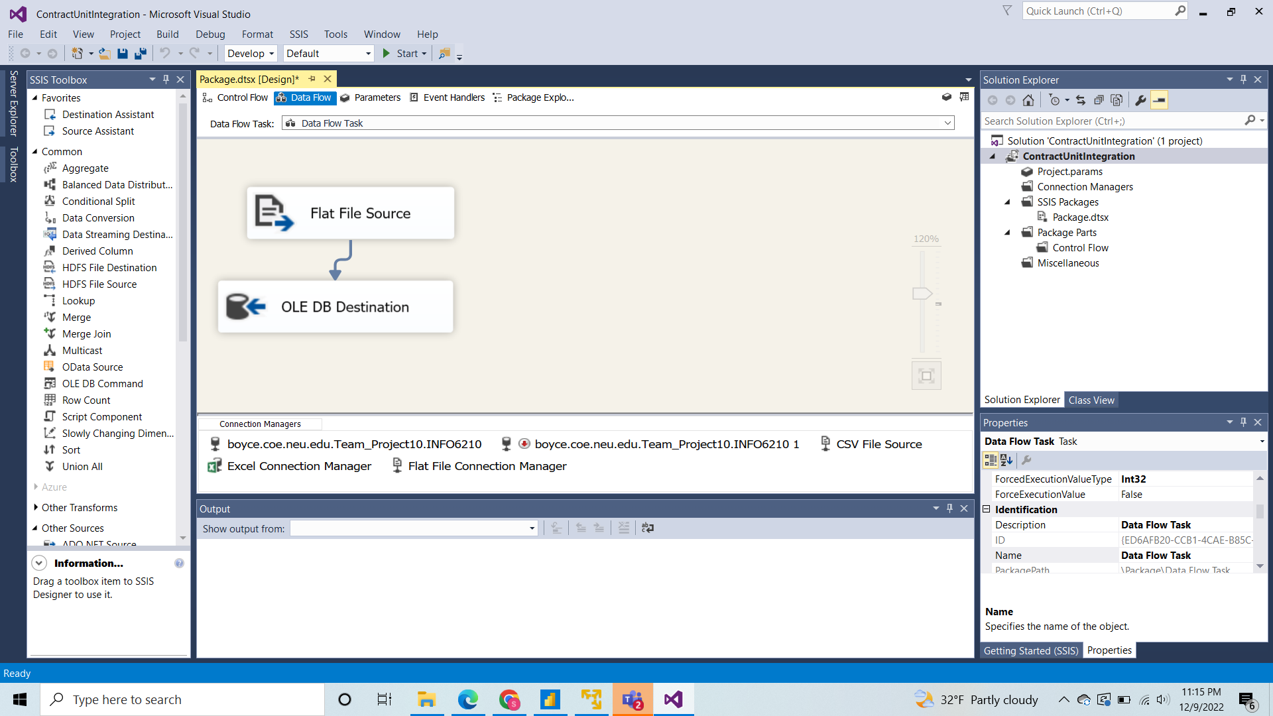
Data Import Wizard

Slide 10
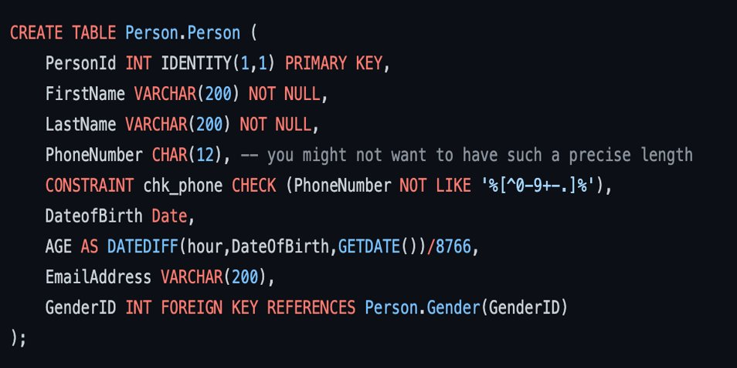
Computed Columns

Slide 11
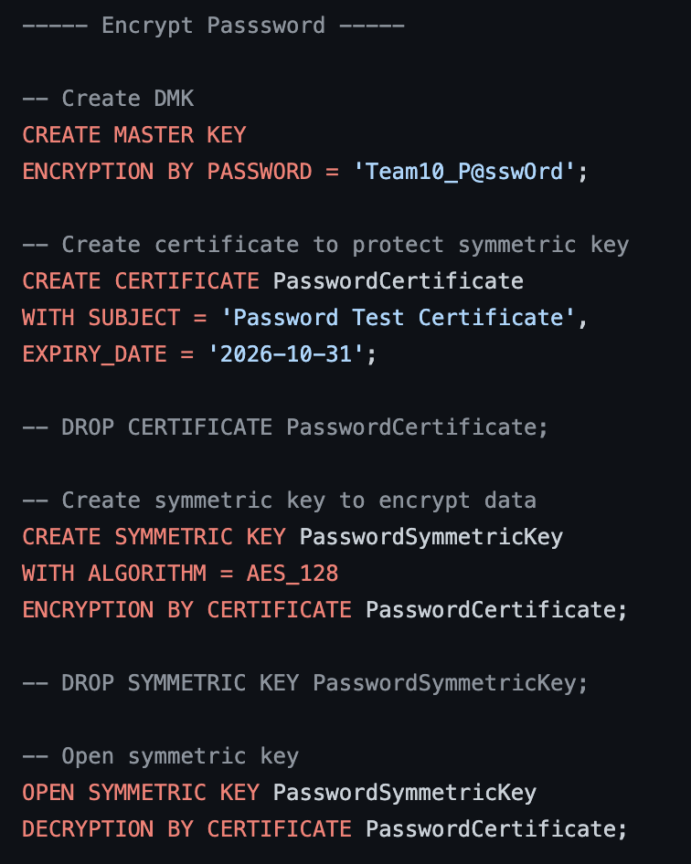
Column Data Encryption: On User Password

Slide 12
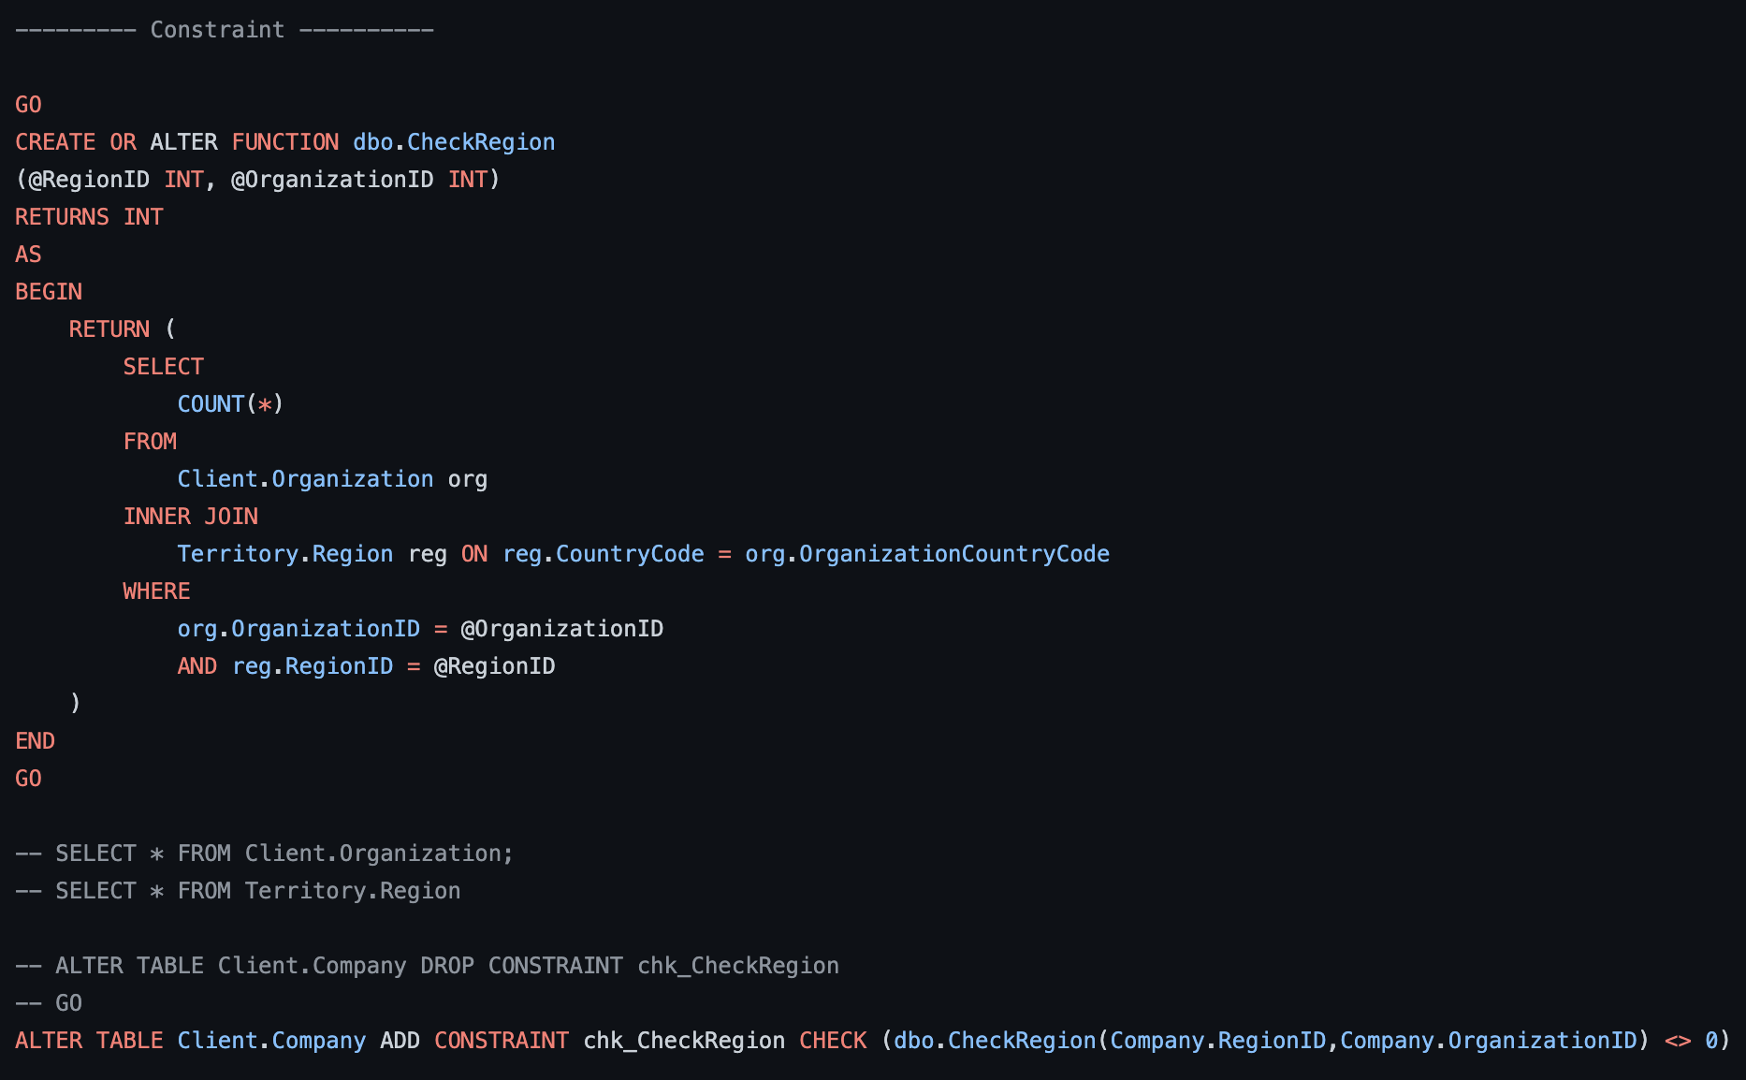
Table Level Check Constraints

Slide 13
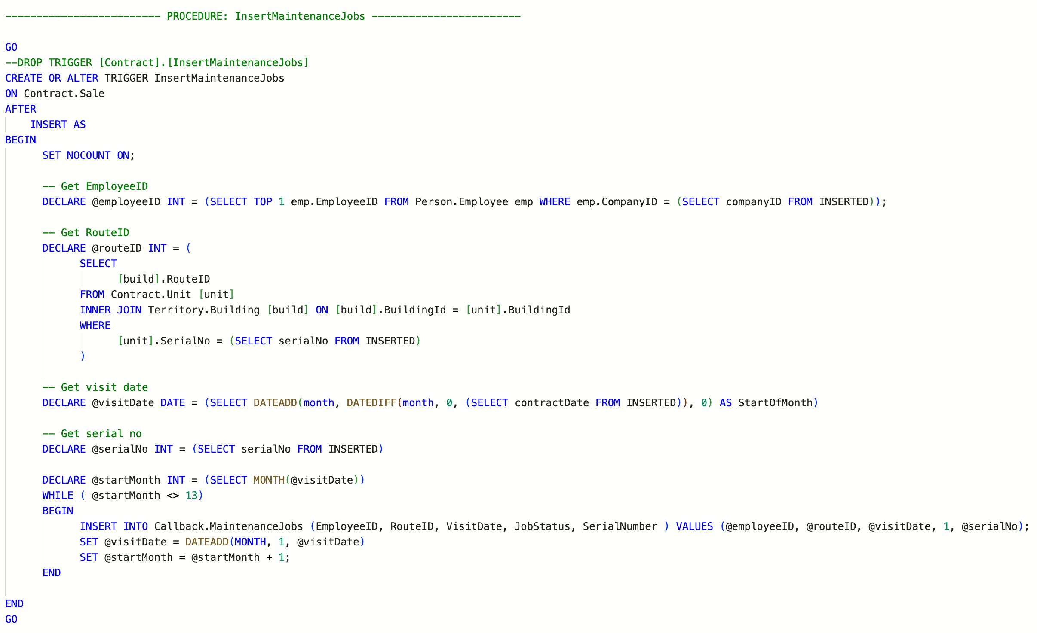
Trigger on Maintenance Jobs

Slide 14
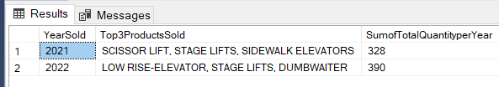
View 1: Top 3 Products per Year

Slide 15
View 1: Implementation
GO
 | CREATE VIEW Top3ProductsperYear as
 | With SumProductsperyear as(SELECT Year(sale.ContractDate) as YearSold,SUM(Quantity) as TotalQuantitySoldperyear
 | From Contract.Sale sale
 | INNER JOIN Contract.Unit unit ON unit.SerialNo=sale.SerialNo
 | INNER JOIN Product.Product product ON product.ProductID=unit.ProductID
 | INNER JOIN Person.Person person ON person.PersonId=sale.SalesRepID
 | INNER JOIN Product.ProductType producttype ON producttype.ProductTypeID=product.ProductTypeID
 | GROUP BY Year(sale.ContractDate)
 | ),
 | ProductTypeSales as(SELECT Year(sale.ContractDate) as YearSold,product.ProductTypeID,producttype.Name,SUM(Quantity) as TotalQuantitySoldperyear
 | From Contract.Sale sale
 | INNER JOIN Contract.Unit unit ON unit.SerialNo=sale.SerialNo
 | INNER JOIN Product.Product product ON product.ProductID=unit.ProductID
 | INNER JOIN Person.Person person ON person.PersonId=sale.SalesRepID
 | INNER JOIN Product.ProductType producttype ON producttype.ProductTypeID=product.ProductTypeID
 | GROUP BY Year(sale.ContractDate),product.ProductTypeID,producttype.Name)
 | SELECT temp.YearSold,STRING_AGG(temp.Name,', ') as Top3ProductsSold,sumperyear.TotalQuantitySoldperyear as SumofTotalQuantityperYear
 | FROM(
 | SELECT YearSold,Name,TotalQuantitySoldperyear,RANK() OVER (Partition By YearSold Order By TotalQuantitySoldperyear DESC) AS Top3ProductsperYear
 | FROM ProductTypeSales) as temp
 | INNER JOIN SumProductsperyear as sumperyear ON sumperyear.YearSold = temp.YearSold
 | WHERE Top3ProductsperYear<= 3
 | GROUP BY temp.YearSold,sumperyear.TotalQuantitySoldperyear
 | GO

Slide 16
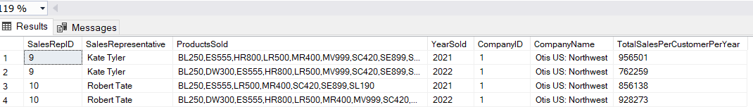
View 2: Yearly Company Sales per Representative

Slide 17
View 2: Implementation
GO
 | CREATE VIEW YearlycompanysalesperRep as
 | WITH temp as (SELECT sale.SalesRepID,person.FirstName+ ' '+person.LastName as SalesRepresentative,sale.CompanyID,company.CompanyName,product.ProductName,Year(sale.ContractDate) as YearSold,SUM((100-sale.Discount)*sale.Quantity*product.FixedPrice)/100 as SalesPerProduct
 | From Contract.Sale sale
 | INNER JOIN Contract.Unit unit ON unit.SerialNo=sale.SerialNo
 | INNER JOIN Product.Product product ON product.ProductID=unit.ProductID
 | INNER JOIN Person.Person person ON person.PersonId=sale.SalesRepID
 | INNER JOIN Client.Company company on company.CompanyID=sale.CompanyID
 | GROUP BY sale.SalesRepID,Year(sale.ContractDate),product.ProductName,sale.CompanyID,person.FirstName,person.LastName,company.CompanyName)
 | SELECT t1.SalesRepID,SalesRepresentative,STRING_AGG(ProductName,',') as ProductsSold,YearSold,CompanyID,CompanyName,CAST(SUM(SalesPerProduct)as int) as TotalSalesPerCustomerPerYear
 | FROM temp t1
 | GROUP BY SalesRepID,YearSold,CompanyID,SalesRepresentative,CompanyName
 | GO

Slide 18
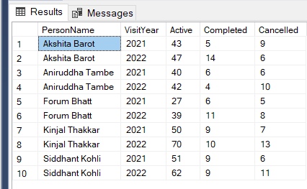
View 3: Maintenance Visits per Year

Slide 19
View3: Implementation
CREATE VIEW MaintenanceVisitsperYear as
 | SELECT maintenance.EmployeeID,person.FirstName+' ' + person.LastName AS 'PersonName',YEAR(maintenance.VisitDate) VisitYear,callstatus.StatusType,Count(JobID) Visits
 | FROM Callback.MaintenanceJobs maintenance
 | INNER JOIN Callback.Status callstatus ON callstatus.StatusID=maintenance.JobStatus
 | INNER JOIN Person.Employee emp ON emp.EmployeeId=maintenance.EmployeeID
 | INNER JOIN Person.Person person ON person.PersonId=emp.EmployeeId
 | GROUP BY maintenance.EmployeeID,callstatus.StatusType,YEAR(maintenance.VisitDate),person.FirstName,person.LastName

Slide 20
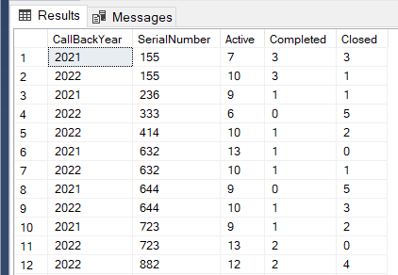
View 4: Yearly Callbacks per Serial #

Slide 21
View 4: Implementation
CREATE VIEW YearlyCallBackPerSerial10 as SELECT * FROM ( SELECT Year(callback.CallbackDate) CallBackYear,callback.SerialNumber,callback.CallbackID,callstatus.StatusType FROM Callback.Callback callback INNER JOIN Callback.Status callstatus ON callstatus.StatusID=callback.StatusID ) src PIVOT ( Count(CallbackID) FOR src.StatusType IN (Active,Completed,Closed) )piv WHERE Active+Closed>=10

Slide 22
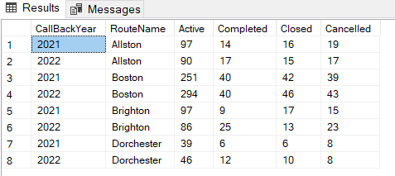
View 5: Yearly Callbacks per Route

Slide 23
View 5: Implementation
CREATE VIEW YearlyCallbacksPerRoute AS SELECT * FROM( SELECT Year(callback.CallbackDate) CallBackYear,terroute.RouteName,callstatus.StatusType,callback.CallbackID FROM Callback.Callback callback INNER JOIN Callback.Status callstatus ON callstatus.StatusID=callback.StatusID INNER JOIN Territory.Route terroute ON terroute.RouteID=callback.RouteID )src PIVOT( COUNT(CallbackID) FOR src.StatusType IN (Active,Completed,Closed,Cancelled) )piv

Slide 24

Reports and visualization

Slide 25
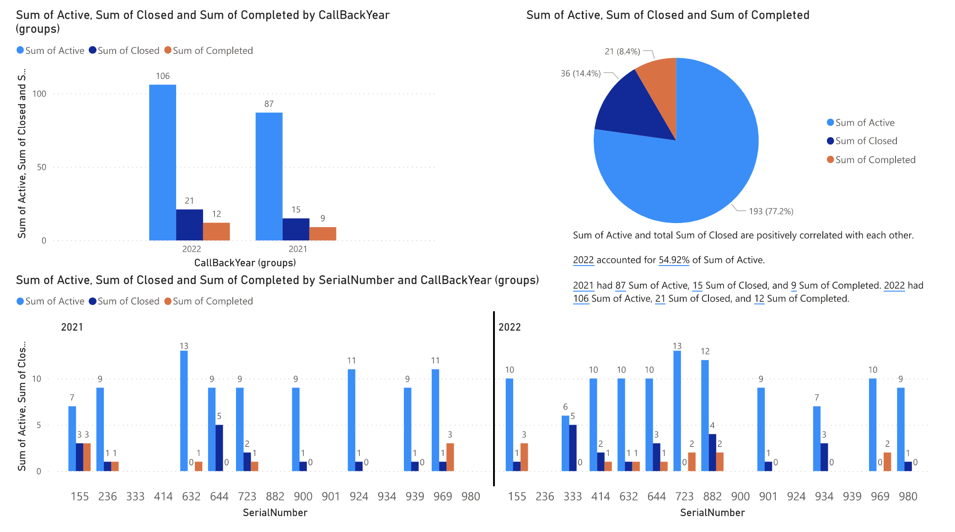
Callbacks per Serial #

Slide 26
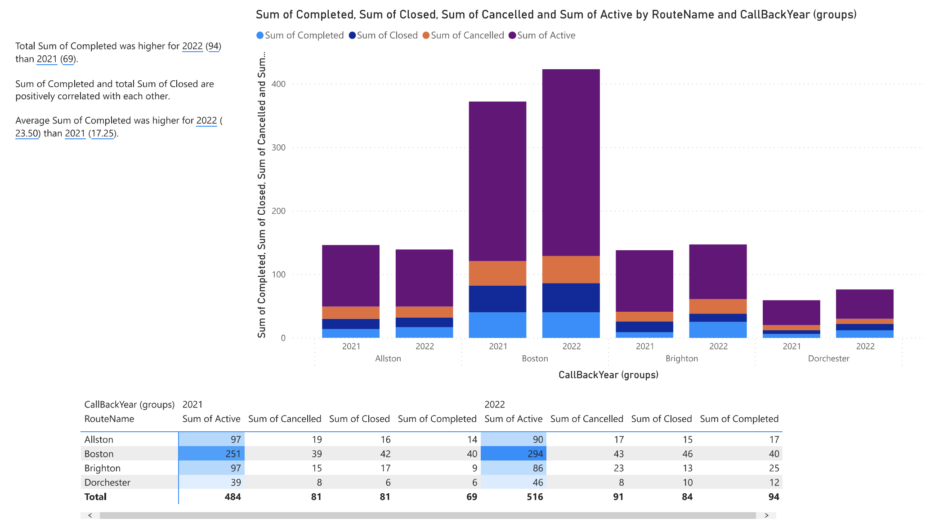
Yearly Callbacks per Route

Slide 27
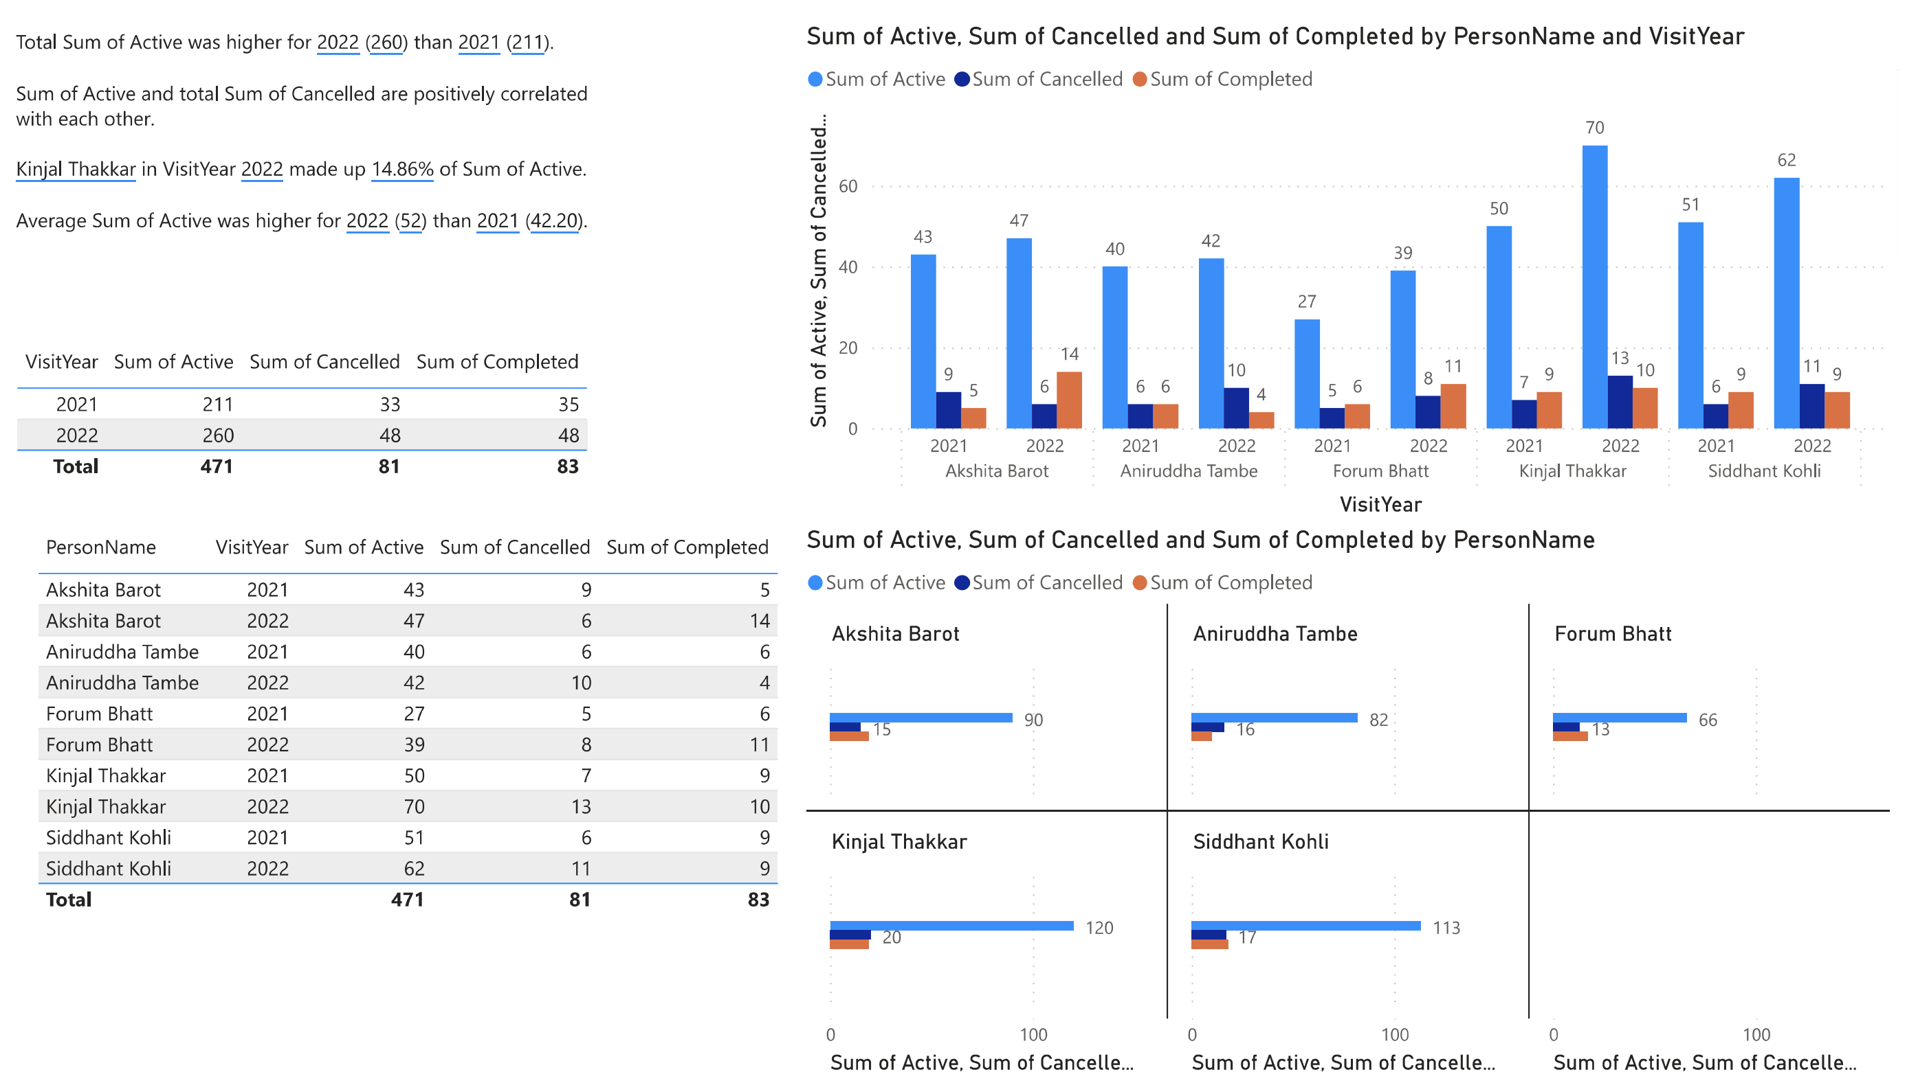
Yearly Callbacks per Mechanic

Slide 28
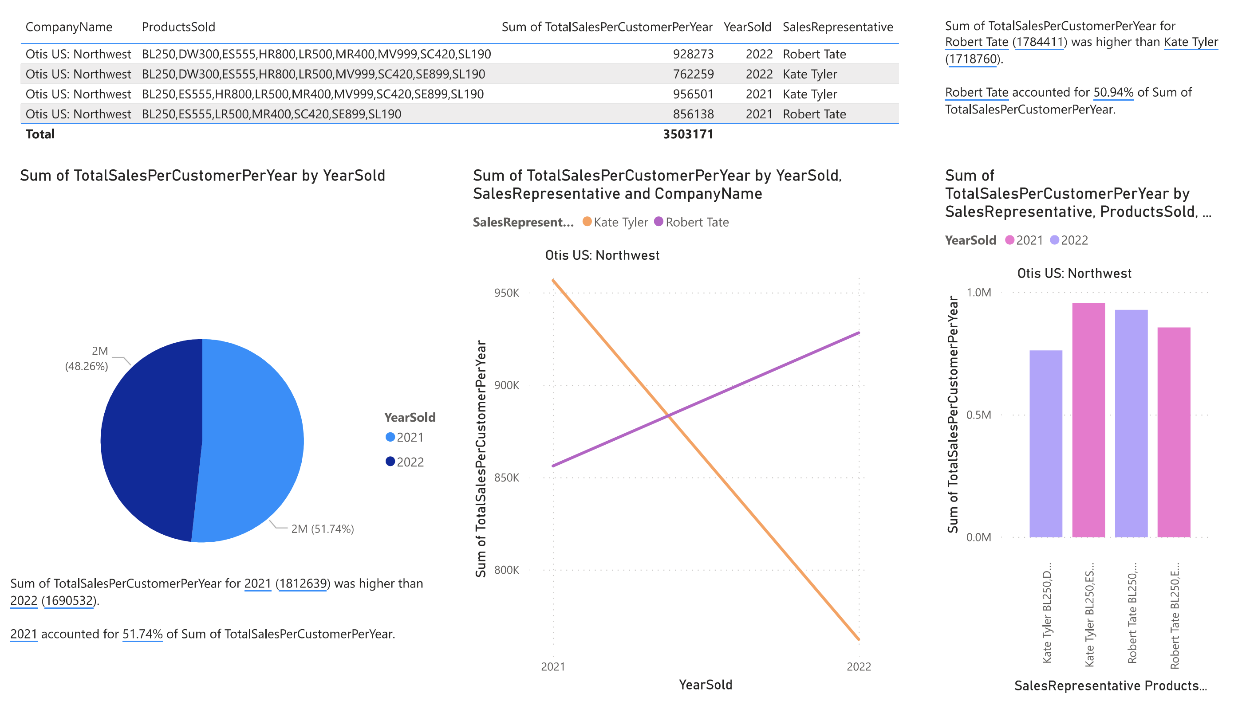
Yearly Sales Pipeline

Slide 29

Conclusion

Slide 30

Any Questions?

